Slide 1
PYTHON
SESSION - II

Slide 2
Topics to be covered
Functions
Lambda function
reduce, map, filter
List comprehensions
File Handling
Exception Handling

Slide 3
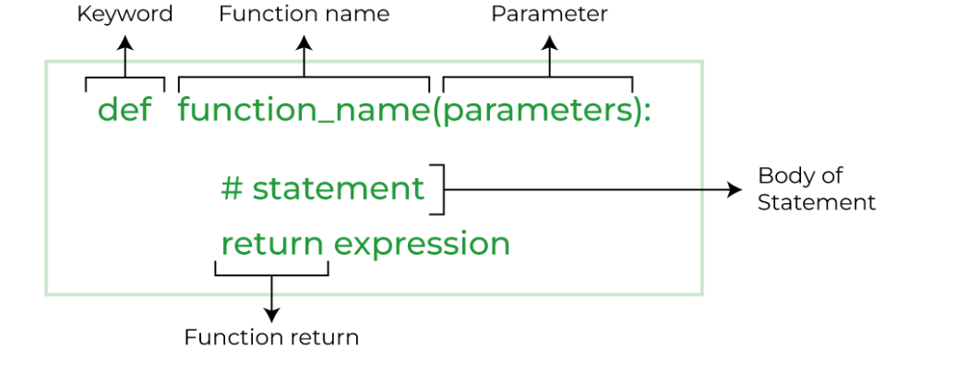
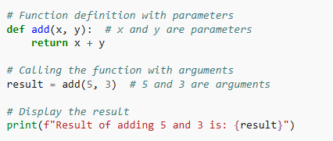
Functions
function is a block of reusable code that performs a specific task.
block of code which only runs when it is called.
a function must be called with the correct number of arguments.
to let a function return a value, use the return statement

Slide 4
Python Function Arguments
arguments are the values passed inside the parenthesis of the function. A function can have any number of arguments separated by a comma
a function must be called with the correct number of arguments.
Types
Default argument
Keyword arguments (named arguments)
Positional arguments
Arbitrary arguments (variable-length arguments *args and **kwargs)

Slide 5
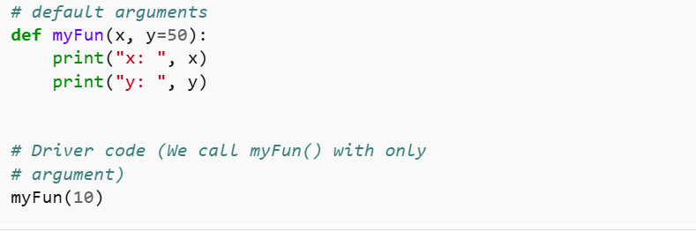
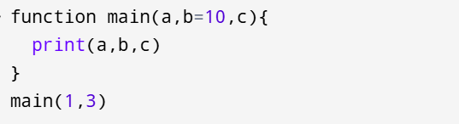
Default Arguments
holds a default value if a value is not provided in the function call for that argument.
once we have a default argument, all the arguments to its right must also have default values.

Slide 6
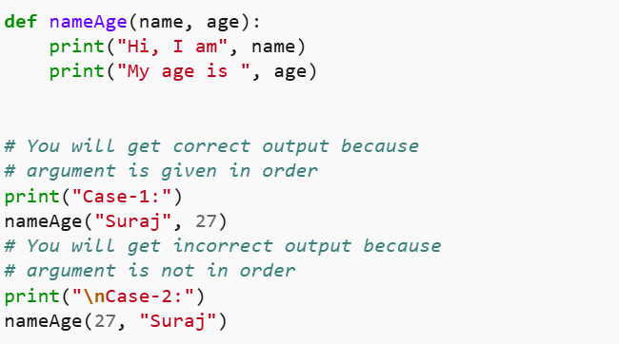
Positional Arguments
arguments that are passed to a function in a specific order, where the position of each argument corresponds to the function's parameter list.

Slide 7
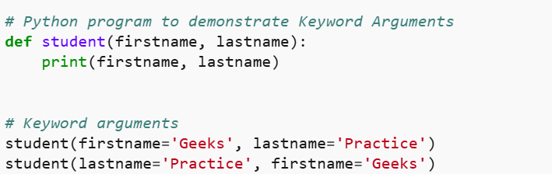
Keyword Arguments
value for argument should be given with a name for it.
the caller does not need to remember the order of parameters.

Slide 8
Arbitrary Arguments *args
If you do not know how many arguments that will be passed into your function, add a * before the parameter name in the function definition.
the function will receive a tuple of arguments, and can access the items accordingly.

Slide 9
Arbitrary Keyword Arguments, **kwargs
If you do not know how many keyword arguments that will be passed into your function, add two asterisk: ** before the parameter name in the function definition.
the function will receive a dictionary of arguments, and can access the items accordingly

Slide 10
Positional-Only and Keyword-Only
To specify that a function can have only positional arguments, add , / after the arguments.
To specify that a function can have only keyword arguments, add *, before the arguments.

Slide 11
Recursion
Recursion is a process where a function calls itself.
Time Complexity: Depends on the problem (e.g., O(n) for factorial).
Space Complexity: Typically O(n) due to the call stack. (stack overflow)

Slide 12

Lambda Function
lambda function can take any number of arguments, but can only have one expression.
Syntax : lambda arguments : expression

Slide 13
filter(), map(), reduce()
Method | Definition | syntax
filter() | Filter() function is used to filter out elements from an iterable (like a list or a set) based on a given condition. It returns a new iterable containing only those elements that satisfy the condition specified by a function. | filter(function, iterable) map(function, iterable) reduce(function, iterable)
map() | The map() function applies a given function to all the items in an iterable (like a list or tuple) and returns a new iterable with the results.
reduce() | The reduce() function is from the functools module and is used to accumulate a result by applying a given function to the items of an iterable. It reduces the iterable to a single cumulative value.

Slide 14
List Comprehensions
shorter syntax when you want to create a new list based on the values of an existing list.
Syntax :
newlist = [expression for item in iterable if condition == True]

Slide 15
File Handling
the process of performing operations on a file such as creating, opening, reading, writing and closing it, through a programming interface.
Create – Open – Read – Write – Close - Delete

Slide 16
modes
"r" - Read - Default value. Opens a file for reading, error if the file does not exist
"a" - Append - Opens a file for appending, creates the file if it does not exist
"w" - Write - Opens a file for writing, creates the file if it does not exist
"x" - Create - Creates the specified file, returns an error if the file exists
"t" - Text - Default value. Text mode
"b" - Binary - Binary mode (e.g. images)
Some combinations such as [r, rb, r+, rb+, w, wb, w+, wb+, a, a+, ab+, x, xb, x+, xb+]

Slide 17
Open a file
open a file we can use open() function, which requires file path and mode as arguments.
file.close() is used to close the opened file
Syntax: open(file_name, mode)

Slide 18
Reading a file
can be achieved by file.read() which reads the entire content of the file.
After reading close the file using file.close().

Slide 19
Writing in a file
file.write()
Overwrites the file. If the file already exists, all its content is erased before new content is added. If the file doesn’t exist, a new one is created.
append - (a) new content to the end of an existing file without erasing its current content. If the file doesn’t exist, a new one is created.

Slide 20
with
used for resource management and exception handling.
simplifies working with resources like files, network connections and database connections by ensuring they are properly acquired and released.
it ensures that they are closed or released automatically, even if an exception occurs
Diff form open()

Slide 21
Exception Handling
handles errors that occur during the execution of a program. Exception handling allows to respond to the error, instead of crashing the running program.

Slide 22
try, except, else and finally Blocks
try Block: Place the code that may raise an exception.
except Block: Catch and handle specific exceptions like ValueError or ZeroDivisionError. You can also use a generic except: to handle all exceptions.
else Block: Executes if no exceptions occur (optional).
finally Block: Executes regardless of whether an exception was raised or not (useful for cleanup tasks like closing files).

